Slide 1
An overview of Java

Slide 2
First Simple Program
/*
This is a simple Java program.
Call this file "Example.java“.
*/
class Example {
// Your program begins with a call to main
public static void main(String args[]) {
System.out.println("This is a simple Java program.");
}
}

Slide 3
First Simple Program cont…
File name
Extension
Compiling
Running a java program
Comments
main()
Case sensitivity

Slide 4
General format of a class
class rectangle{
data
length;
breadth;
code
setMeasure()
area()
perimeter()
}

Slide 5
Java Is a Strongly Typed Language
First, every VARIABLE has a type, every EXPRESSION has a type, and every TYPE is strictly defined.
Second, all ASSIGNMENTS, whether explicit or via parameter passing in method calls, are checked for type compatibility.
There are no automatic coercions or conversions of conflicting types as in some languages.

Slide 6
Java Is a Strongly Typed Language
The Java compiler checks all EXPRESSIONS and parameters to ensure that the types are compatible.
Any type mismatches are errors that must be corrected before the compiler will finish compiling the class.

Slide 7
Designing data
constant
Variable
Identifier
  Identifier naming rules
    may be any descriptive sequence of uppercase and lowercase letters, numbers, or the underscore and dollar-sign characters.
    They must not begin with a number
    Java is case-sensitive, so VALUE is a different identifier than Value.

Slide 8
Data types
There are 8 primitive types
Integers This group includes byte, short, int, and long, which are for whole-valued signed numbers.
Floating-point numbers This group includes float and double, which represent numbers with fractional precision.

Slide 9
Data types
Characters This group includes char, which represents symbols in a character set, like letters and numbers.
•Boolean This group includes boolean, which is a special type for representing true/false values.

Slide 10
Designing data: Data types
Simple Types (B) Floating Point
Name | Width | Range
double | 64 | 4.9e–324 to 1.8e+308
float | 32 | 1.4e−045 to 3.4e+038
Float single precision usually faster
Double precision faster in modern processors

Slide 11
Designing data: Data types
Simple Types (A) Integers
Name | Width | Range
long | 64 | –9,223,372,036,854,775,808 to 9,223,372,036,854,775,807
int | 32 | –2,147,483,648 to 2,147,483,647
short | 16 | –32,768 to 32,767
byte | 8 | -128 to 127
No unsigned integer
Type promotion for byte or short in expression

Slide 12
Designing data: Data types
Simple Types (C) Characters
Name | Width | Range
char | 16 | 0-65,536
No negative chars
ASCII 0-127
ISO-Latin-1 0-255
Old tricks work

Slide 13
Designing data: Data types
Simple Types (D) Boolean
  two values i.e true or false
  3 things
    When printed output is true/false
    If(b) can be used without == operator
    It is the outcome of a relational operator
    System.out.println(“the greater value is “+(10>9);

Slide 14
Literals
Integer literals
  1 or 2 or 56 are integers (base 10) by default
byte, short
  integer values can be assigned well within their range
long
  12L or 12l
octal
  07 not 09
hexadecimal
  0xA78

Slide 15
Literals
With JDK7 it is possible to specify integer literals using binary
  int x = 0b1010;
Embedding of underscores (ultimately ignored)
  int x = 123_456_789;
  int x = 123___456___789;
  int x = 0b1101_0101_0001_1010;
  //underscore not allowed at the beginning and the end

Slide 16
Literals cont…
floating point literals
  12.56 //defaults to double
  12.34F or 12.34f //float literal
  12.56d or D but redundant
  Scientific notation can be used
    floating-point number plus a suffix that specifies a power of 10 by which the number is to be multiplied.
    The exponent is indicated by an E or e followed by a decimal number, which can be positive or negative.
    Examples include 6.022E23, 314159E–05, and 2e+100.
  double num = 9_423_497_862.0;
  0x12.2P2 represents 72.5 (hexadecimal notation)

Slide 17
Literals cont…
boolean literals

Slide 18
Literals cont…
Character literals
  ‘a’ , ‘#’
  octal notation: \followed by 3 digits :‘\141’ –’a’
  hexadecimal notation: \ followed by four digits ‘\u0061’ –’a’, ‘\ua432’
  ‘\’’
  ‘\\’
String literals
  “hello world”
  “\”Quoted\””
  “two \n lines”

Slide 19
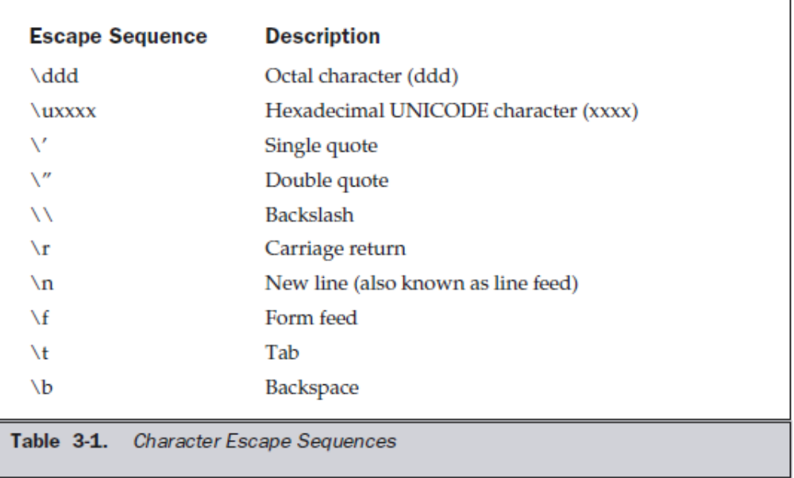
Escape sequences

Slide 20
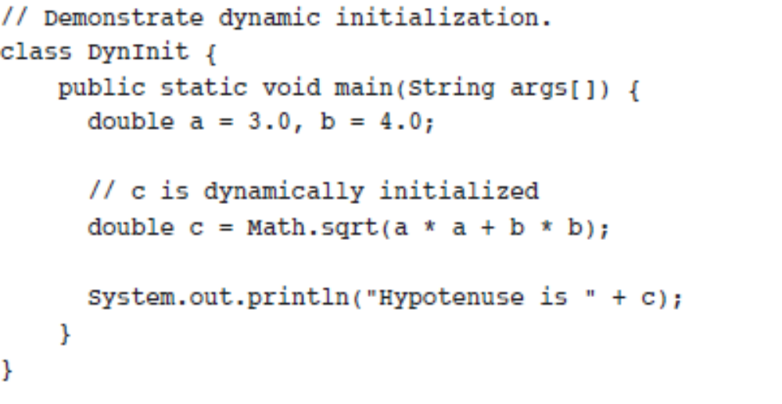
Dynamic initialization

Slide 21
Scope of variables
A block defines a scope
each time you start a new block, you are creating a new scope
scope determines what objects are visible to other parts of your program
it also determines the lifetime of those objects

Slide 22
Scope of variables cont…
As a general rule, variables declared inside a scope are not visible (that is, accessible) to code that is defined outside that scope
Scopes can be nested. When this occurs, the outer scope encloses the inner scope.
This means that objects declared in the outer scope will be visible to code within the inner scope. However, the reverse is not true.

Slide 23
Scope of variables cont…
variables are created when their scope is entered, and destroyed when their scope is left
Thus, the lifetime of a variable is confined to its scope
Although blocks can be nested, you cannot declare a variable to have the same name as one in an outer scope. In this regard, Java differs from C and C++.

Slide 24
Java’s Automatic Conversions
The two types are compatible.
The destination type is larger than the source type

Slide 25
Java’s Automatic Conversions
widening conversion
  E.g byte to int
  Integer and floating types are compatible with each other
  No automatic conversion from numeric to char
  char and boolean are not compatible
Automatic conversion occurs when integer literals are assigned to byte, short, long and char

Slide 26
Casting
narrowing conversion
  truncation and reduced modulo
  int to byte
  float to int

Slide 27
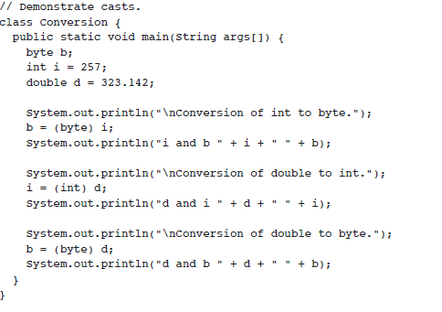

Slide 28
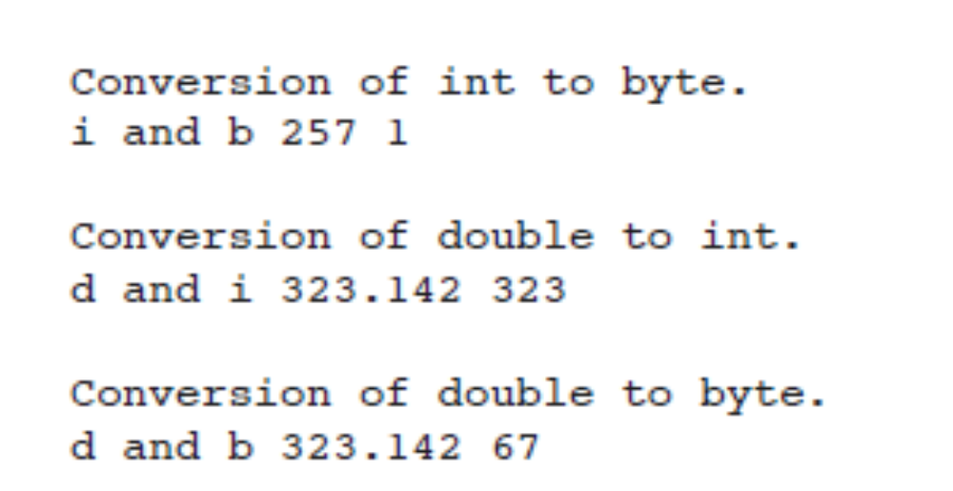
output

Slide 29
Automatic Type Promotion in Expressions
byte a = 40;
byte b = 50;
byte c = 100;
int d = a * b / c; //Refer Note A
byte b = 50;
b = b * 2; //Refer Note B
Notes:
//A expression converted to int
// B Error! Cannot assign an int to a byte!

Slide 30
Type Promotion Rules
First, all byte and short values are promoted to int
Then, if one operand is a long, the whole expression is promoted to long
If one operand is a float, the entire expression is promoted to float.
If any of the operand is double, the result is double

Slide 31
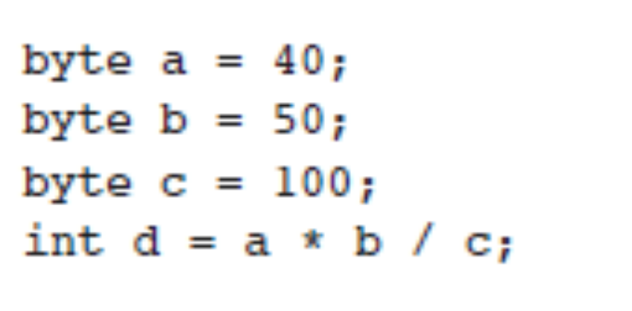
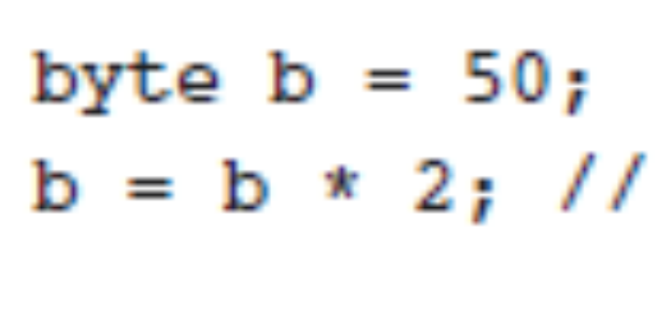

Slide 32
Type Promotion Rules cont…
byte b = 42;
char c = 'a';
short s = 1024;
int i = 50000;
float f = 5.67f;
double d = .1234;
double result = (f * b) + (i / c) - (d * s);
System.out.println("result = " + result);

Slide 33
Type Promotion Rules cont…
In the first subexpression, f * b, b is promoted to a float and the result of the subexpression is float.
Next, in the subexpression i / c, c is promoted to int, and the result is of type int.
Then, in d * s, the value of s is promoted to double, and the type of the subexpression is double.
Finally, these three intermediate values, float, int, and double, are considered.
The outcome of float plus an int is a float.
Then the resultant float minus the last double is promoted to double, which is the type for the final result of the expression.

Slide 34
Arrays
Single dimensional
  int array[] =new int[4];
Multidimensional
  int array[][]=new int[4][5];
  int array[][]=new int[4][];
  int array[0]=new int[5];

